Slide 1
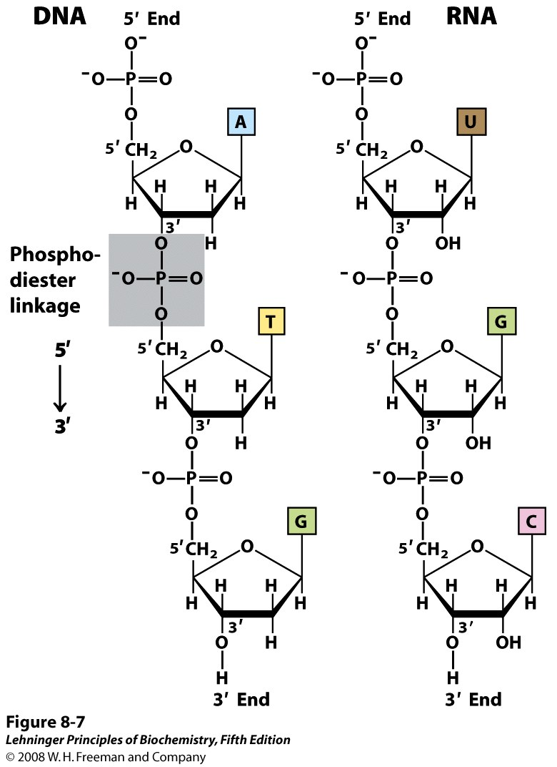
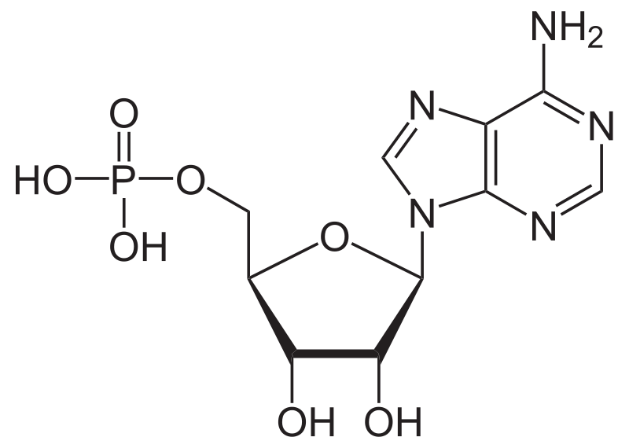
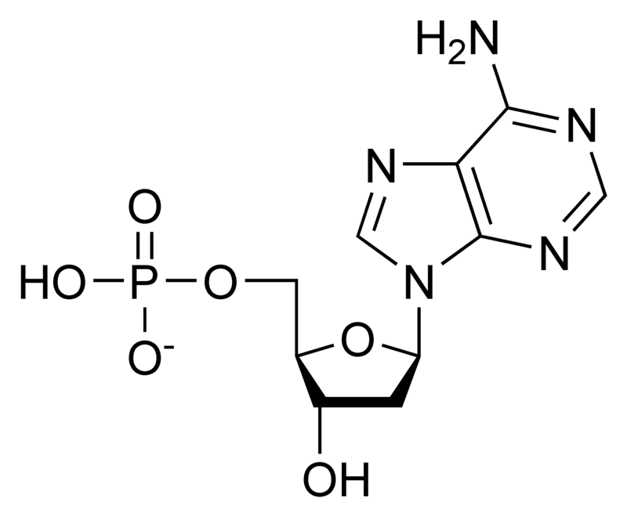
Phosphodiester linkage
Lecture - 2
Adenylate
Deoxy adenylate

Slide 2
DNA as genetic material
Griffith’s experiment (1928) - "transforming principle" in pneumococcus bacteria
Avery–MacLeod–McCarty experiment (1944) – Identified DNA as the substance causing bacterial transformation
Hershey-Chase experiment (1952) – Confirmed DNA as a genetic material of virus

Slide 3
Chargaff’s rule
Erwin Chargaff, 1940
1. The base composition of DNA generally varies from one species to another.
2. DNA specimens isolated from different tissues of the same species have the same base composition.
3. The base composition of DNA in a given species does not change with an organism’s age, nutritional state, or changing environment.
4. In all cellular DNAs, regardless of the species, the number of adenosine residues is equal to the number of thymidine residues (that is, A T), and the number of guanosine residues is equal to the number of cytidine residues (G C).
From these relationships it follows that the sum of the purine residues equals the sum of the pyrimidine residues; that is, A + G = T + C

Slide 4
1.03
1.01
1.00
1.00
1.00
0.99
1.00
1.03
0.99
1.00
(A + G) / (T + C)

Slide 5
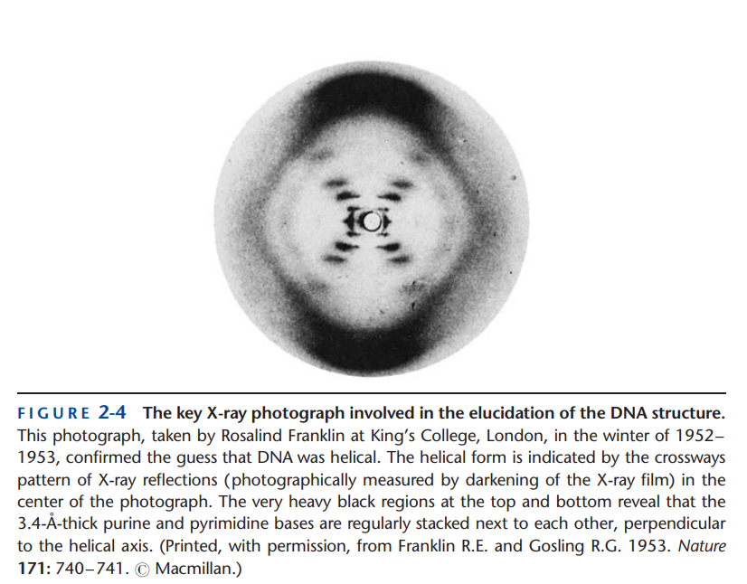
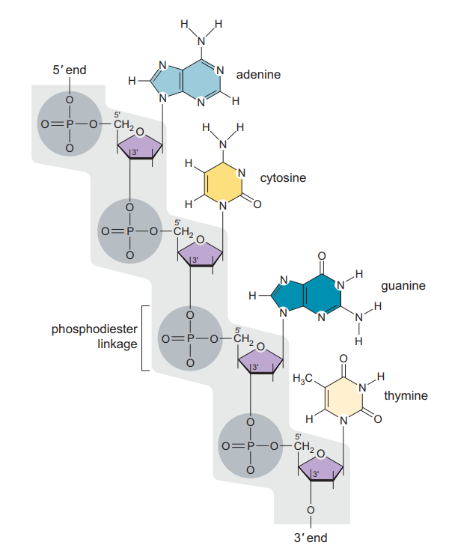
It was not until the early 1950s that high-quality X-ray diffraction photographs were taken by Maurice Wilkins and Rosalind Franklin (Fig. 2-4). These photographs suggested not only that the underlying DNA structure was helical but that it was composed of more than one polynucleotide chain—either two or three. At the same time, the covalent bonds of DNA were being unambiguously established. In 1952 a group of organic chemists working in the laboratory of Alexander Todd showed that 30 –50 phosphodiester bonds regularly link together the nucleotides of DNA (Fig. 2-5).
James D. Watson - Molecular Biology of the Gene, 7th Ed

Slide 6
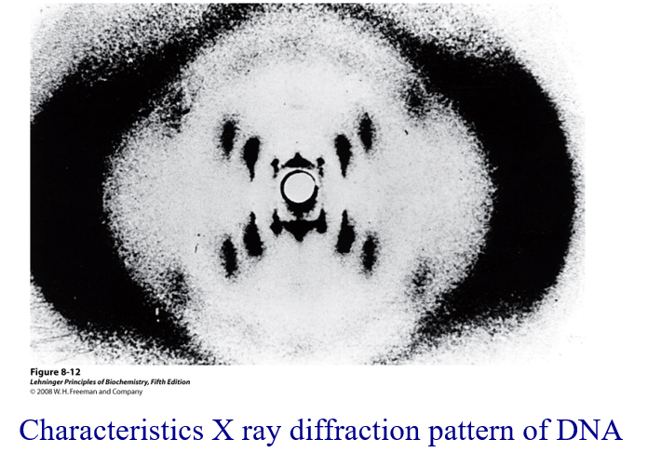
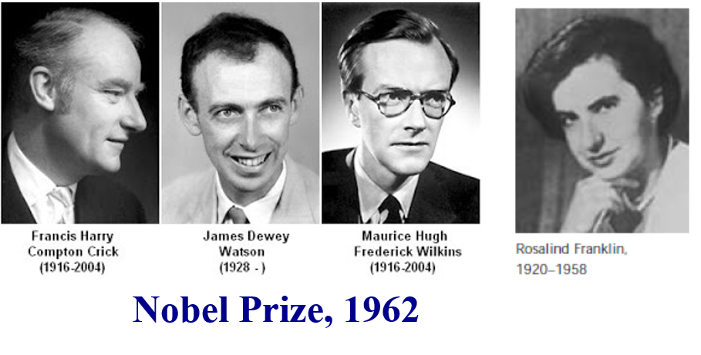
Discovery of DNA structure
From Maurice Wilkins Nobel Lecture

Slide 7
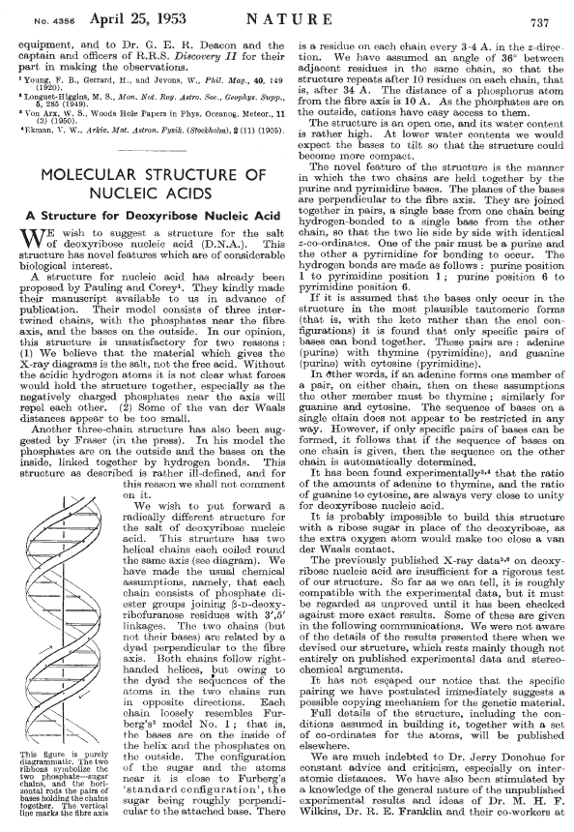

Slide 8
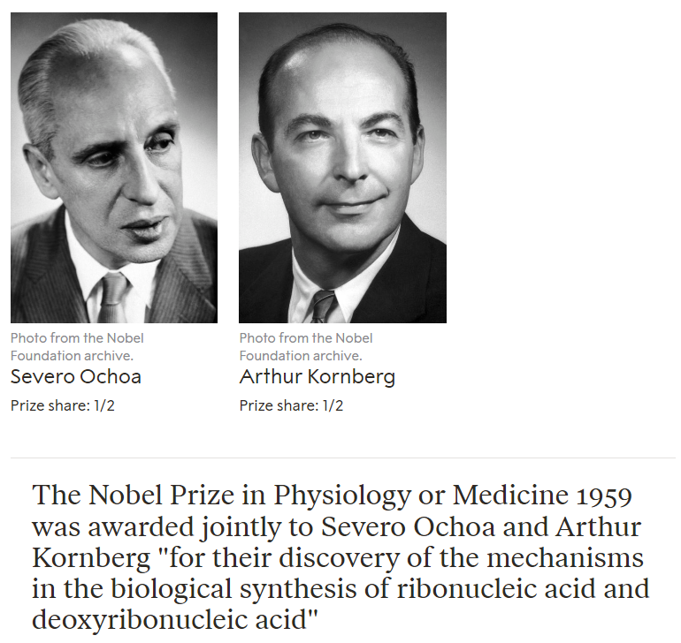

Slide 9
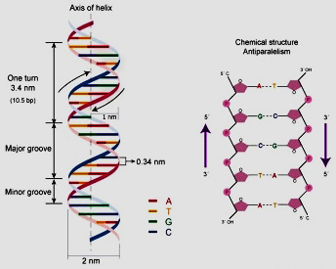
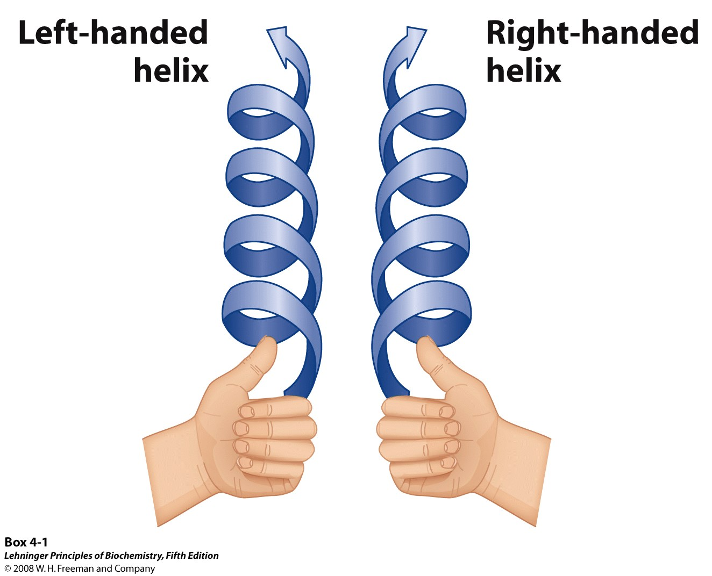
DNA double helix
Two helical DNA chains twisted around the same axis to form a right-handed double helix
The hydrophilic backbones of alternating deoxyribose and phosphate groups are on the outside of the double helix, facing the surrounding water.
The hydrophobic purine/pyrimidine rings faces inward perpendicular to the axis and pair with one another by forming H-bond between A-T and G-C
Diameter of the helix is 20 Å. There is a complete turn every 34 Å with 10 base pairs per turn.
The double helix is consist of a major groove and a minor groove.

Slide 10
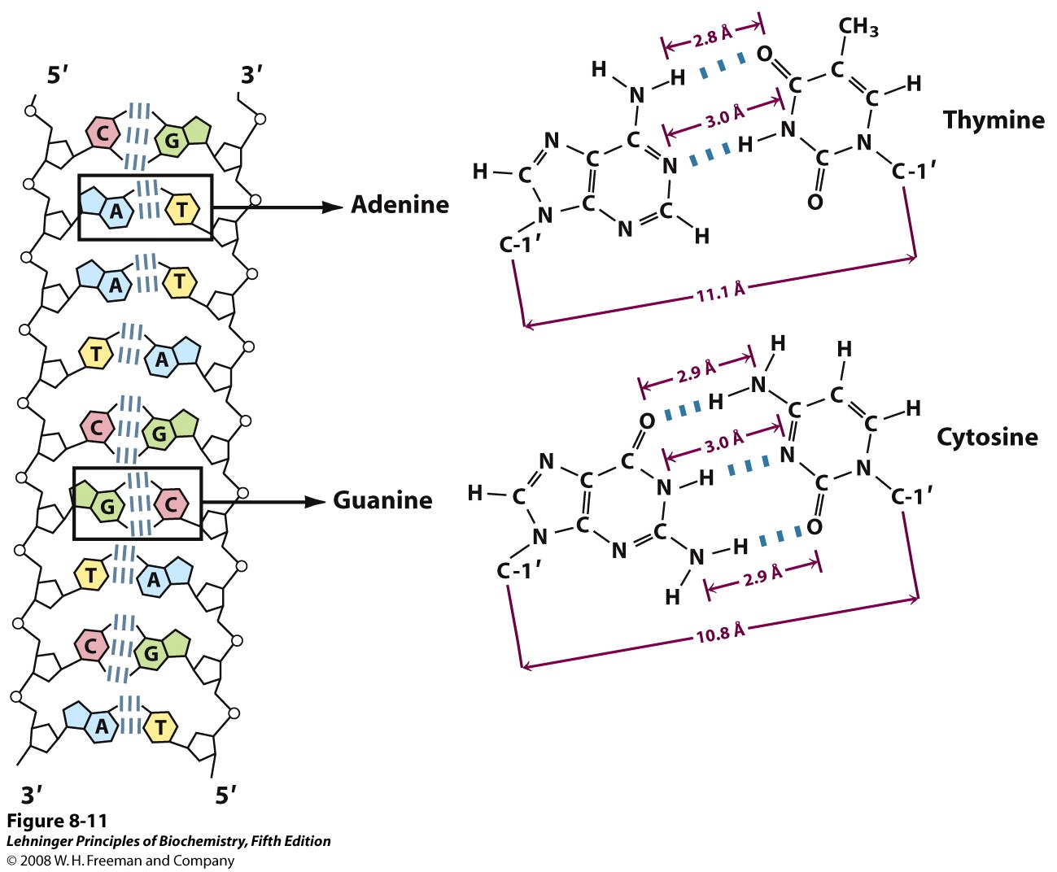
Complementarity of strands in the double helix
The strands are antiparallel

Slide 11
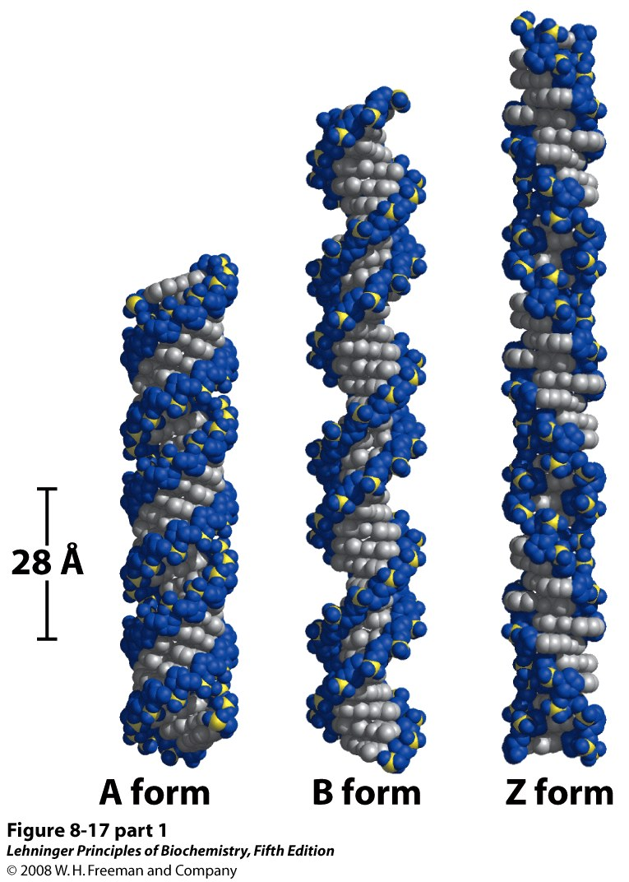
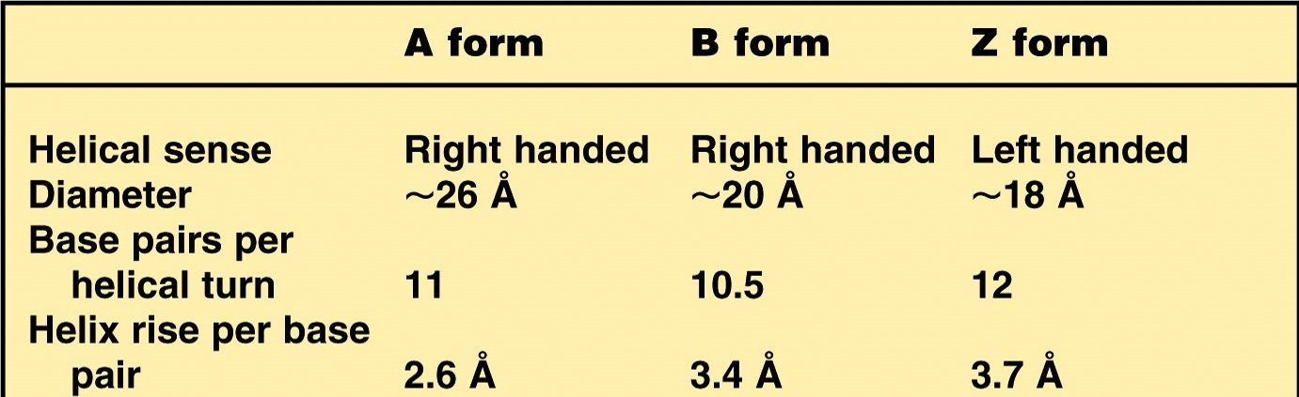
Multiple conformation of the double helix
Notes:
FIGURE 8-17 (part 1) Comparison of A, B, and Z forms of DNA. Each structure shown here has 36 base pairs. The bases are shown in gray, the phosphate atoms in yellow, and the riboses and phosphate oxygens in blue. Blue is the color used to represent DNA strands in later chapters. The table summarizes some properties of the three forms of DNA.

